Slide 1
Husky Eats
Project done by Afrah Fathima Shahabuddin
Balaji Sundar Anand Babu
Pradeep Kumar Vijayakumaran

Slide 2
Introduction
Husky Eats is a community-driven platform created to improve university staff and students eating and grocery buying experiences. By providing this lively community with a wide variety of nearby restaurants and supermarkets, we hope to promote the discovery of both delectable foods and necessary daily necessities. Enjoying meals and stocking up on groceries is made easier by the platform's ability to let users share their eating experiences, write reviews, and find new possibilities. Husky Eats wants to establish itself as the premier destination for those seeking to socialise with their peers and savour delicious meals.

Slide 3
Technology Used
Software & Languages Used:
· Database Management System : MYSQL for structured and relational storage.
· Database Management Interface : MYSQL WorkBench
· Backend Framework : Flask , integration and control.
· Frontend Stack : HTML,CSS,Bootstrap for creating an interactive and decorated user interface.
· Repository Management: GitHub, utilized for version control and collaborative coding.

Slide 4
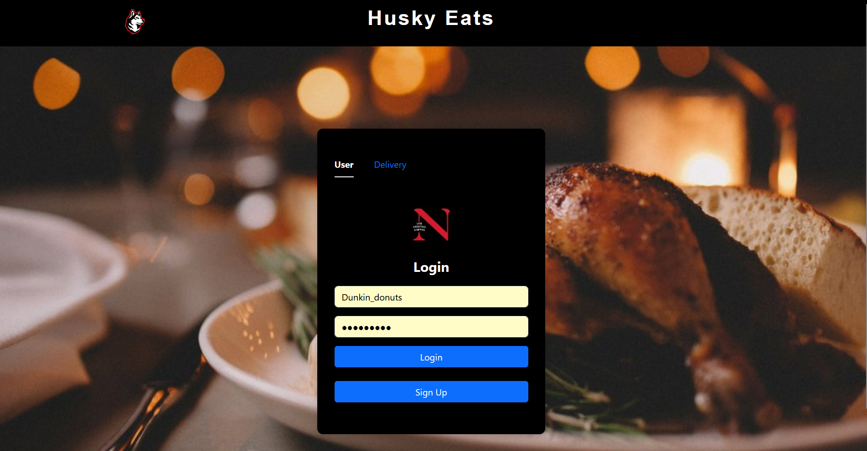
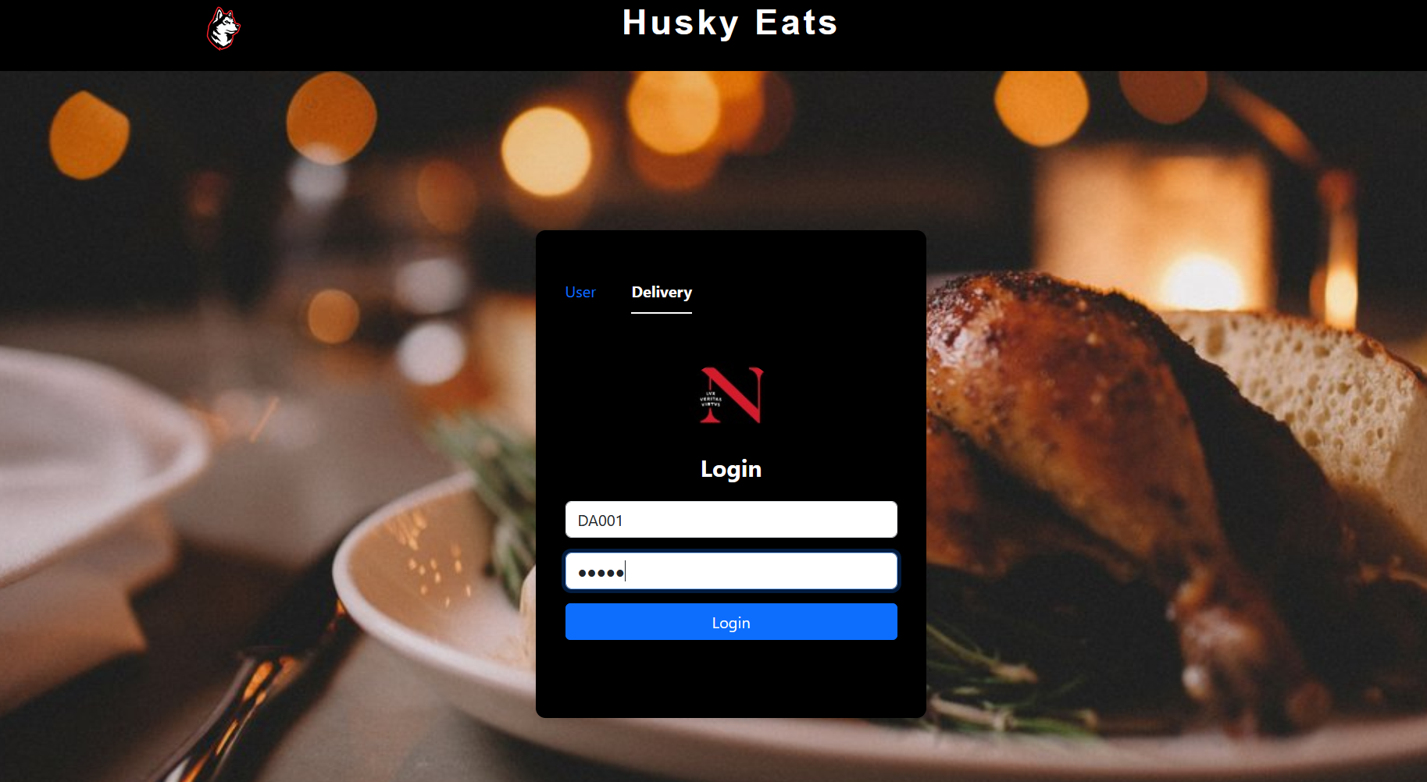
Visual Representation of the Website
When the website is hosted , the first page that comes up is the login page User or the delivery agent can login into the website with their appropriate user credentials.

Slide 5
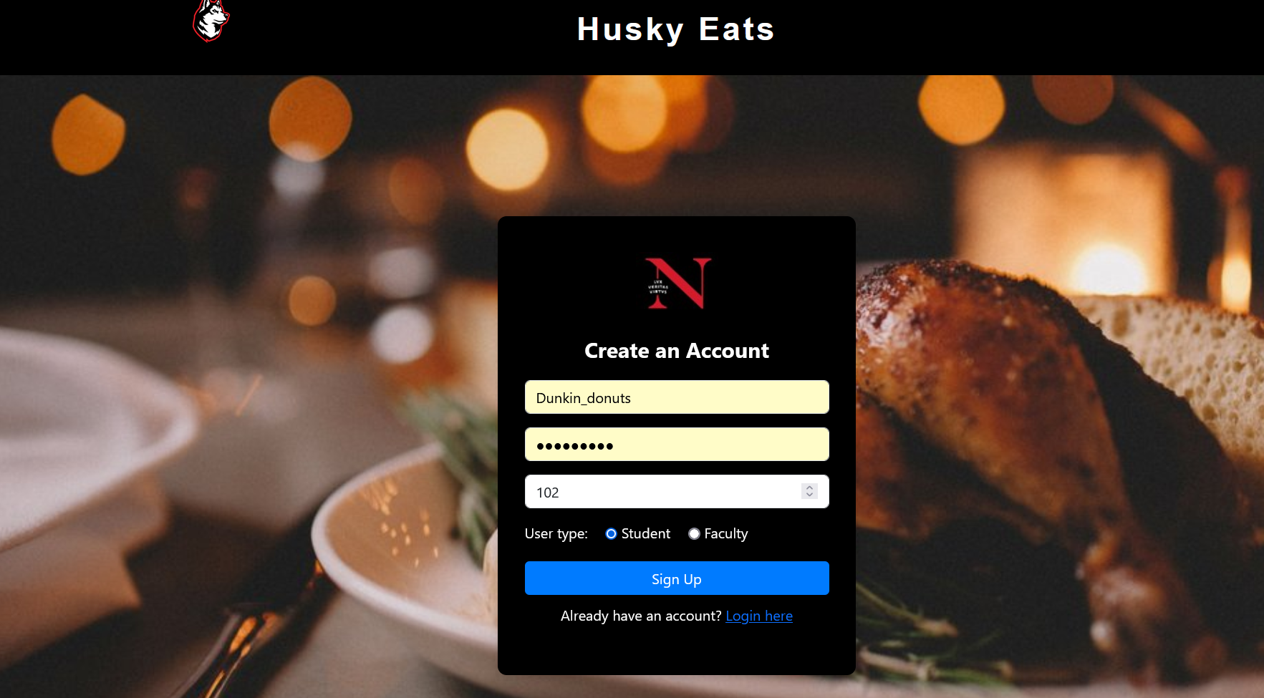
Sign Up Page
If the user does not have an account for the website then they have an option to sign up and create an account by setting up the credentials Student and Faculty can sign up for an account in the website

Slide 6
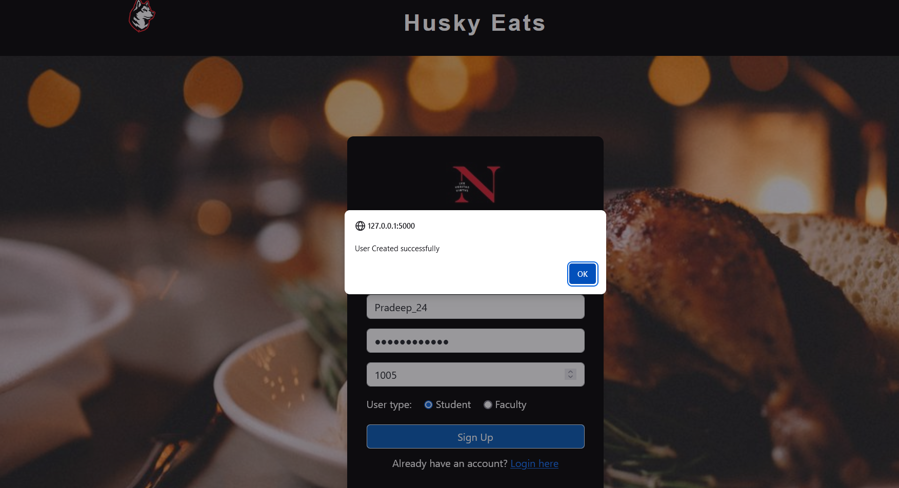
Account created successfully

Slide 7
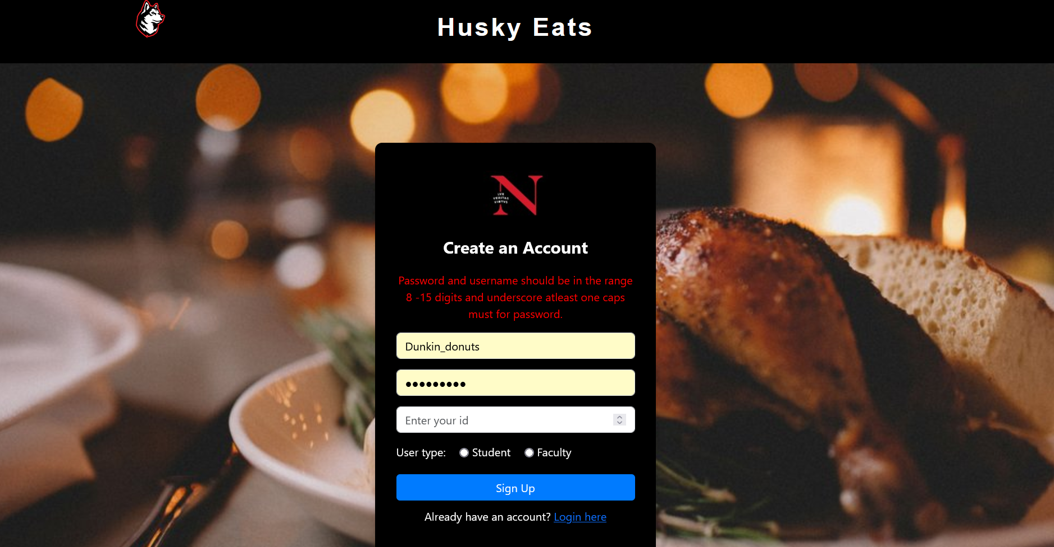
The user gets notified if the username or password entered does not follow the required format. This implies to both Student and Faculty.

Slide 8
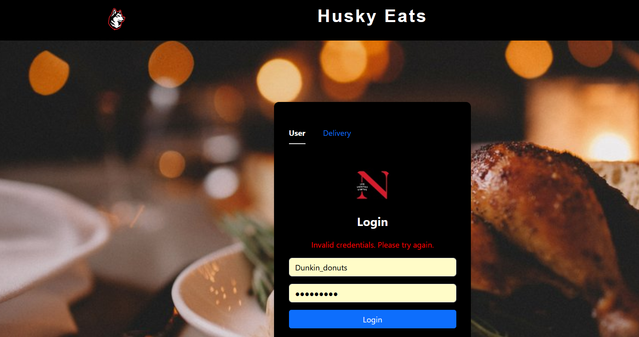
Invalid Credentials
The user gets notified if the user enters invalid credentials to log in.

Slide 9
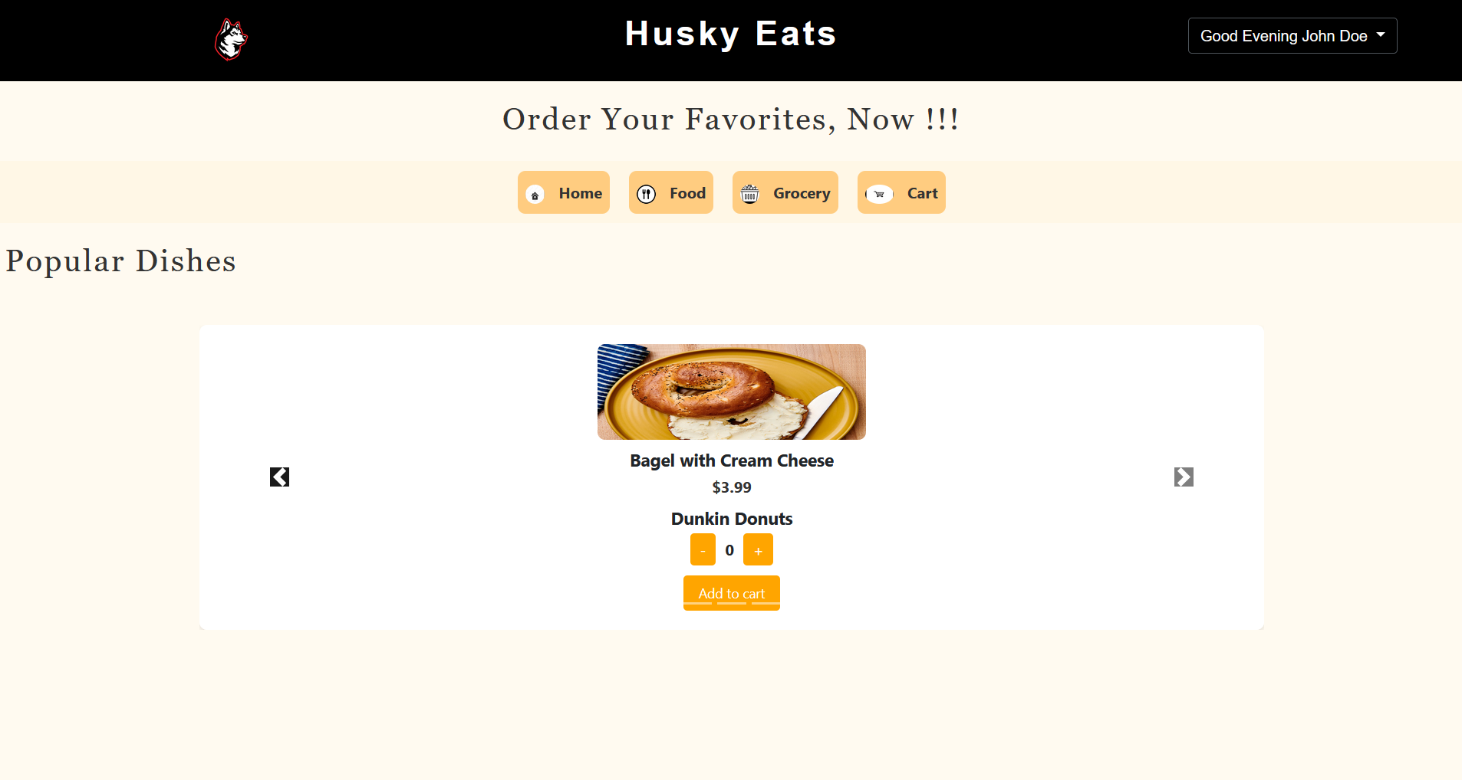
Home Page
Once the user logs in with their respective credentials , they land on the home page which shows the various categories of food and groceries available in the stores and also shows a few popular dishes available across the stores .
The user can choose any item and its quantity and add it to cart.

Slide 10
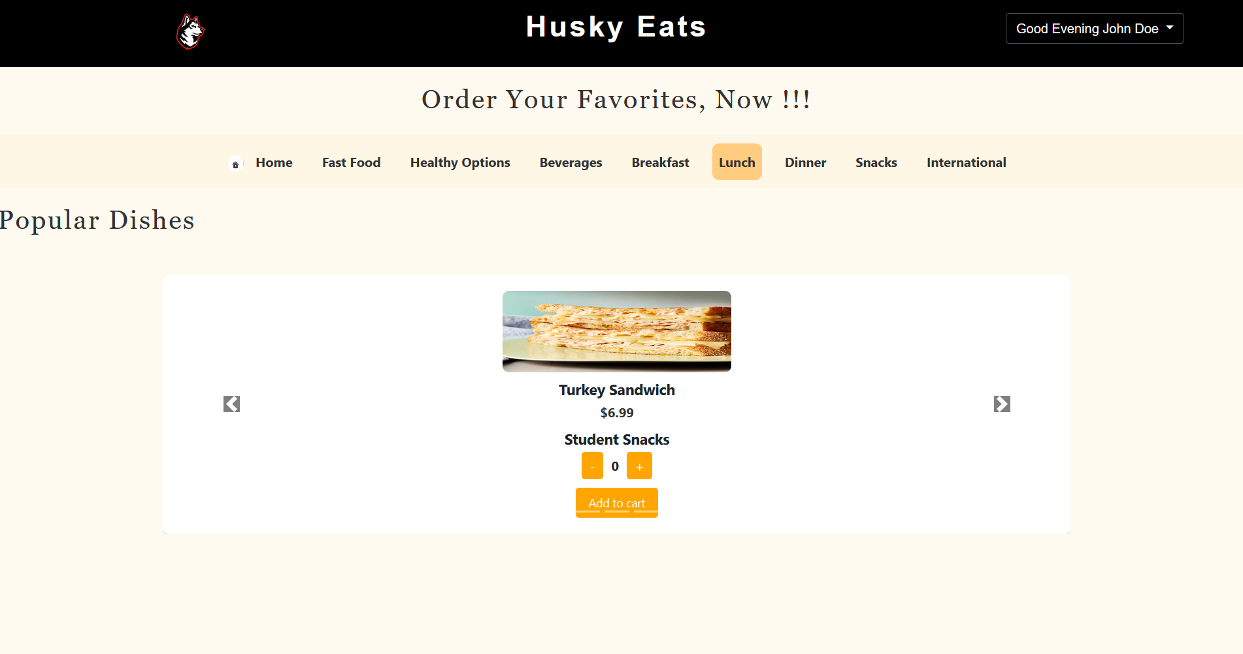
Food Category Page
Clicking on the Food Category will open the above page. The Food category has multiple options available as displayed in the nav bar . User can choose any option (for example “Lunch”) and choose any item and add it to cart

Slide 11
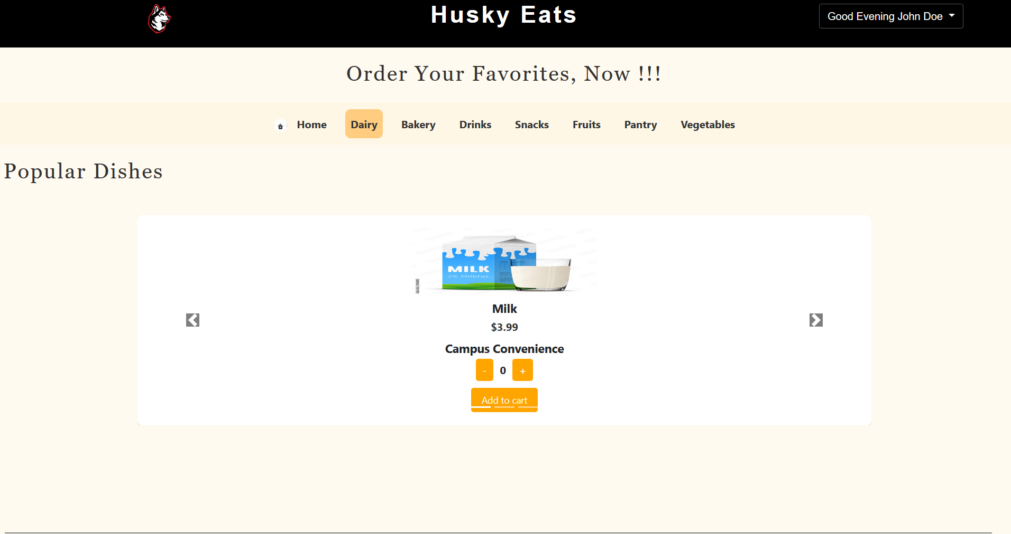
Grocery Category Page
Clicking on the Grocery Category will open the above page. The Grocery category has multiple options available as displayed in the nav bar . User can choose any option (for example “Diary”) and choose any item and add it to cart .

Slide 12
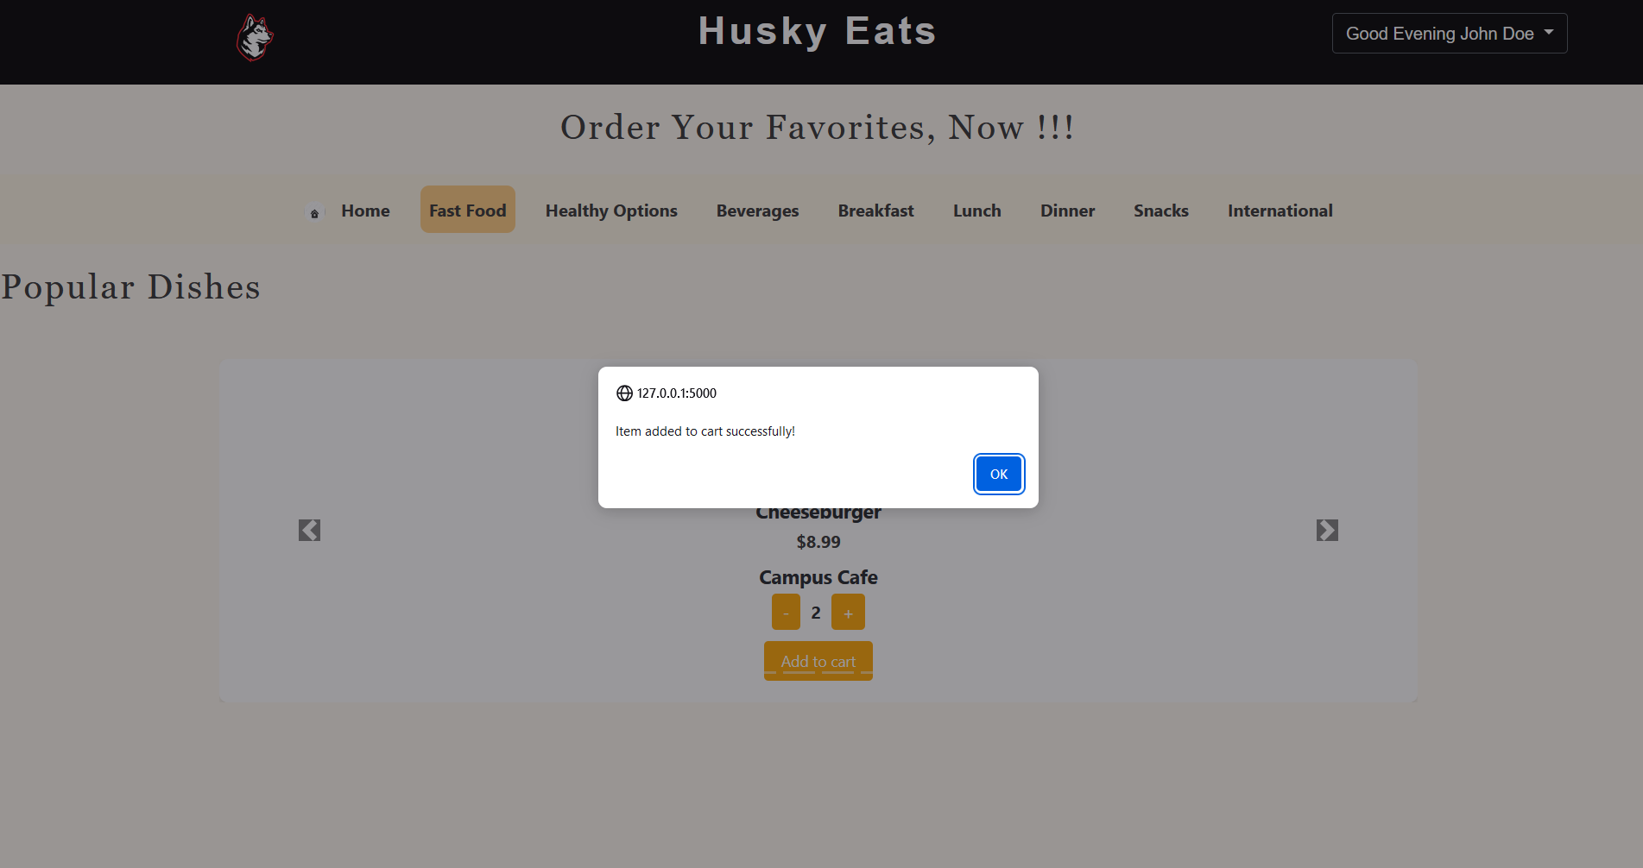
When the item is chose and added to cart , the user is notified with a simple pop up for confirmation.

Slide 13
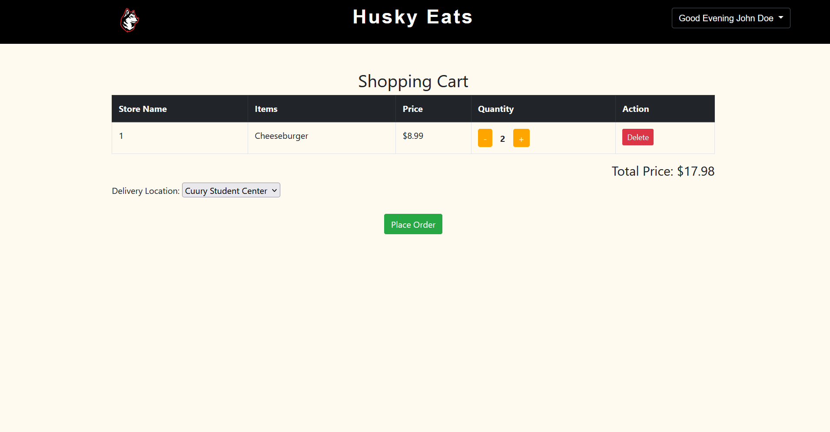
Cart Page
As the user added the items to cart , they can navigate to the cart page to view the items and further proceed and place the order . Before the order is placed the delivery location has to be selected such that the order can be delivered to that location appropriately. Clicking on the “Place Order” Button will place the order and the user will get an OTP that is auto generated to their respective email so that when the user receives the order t, they have to tell the OTP to the delivery agent such that he can confirm the order delivery.

Slide 14
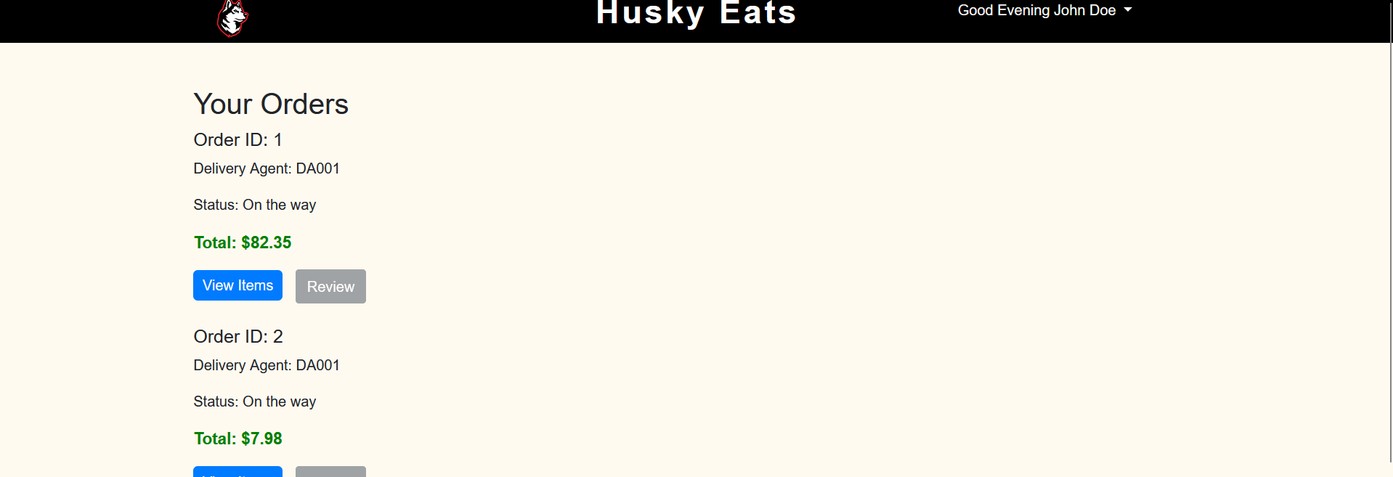
Order Page
User can also navigate to the orders page from the Home page to view their order and also to view the Delivery Status.

Slide 15
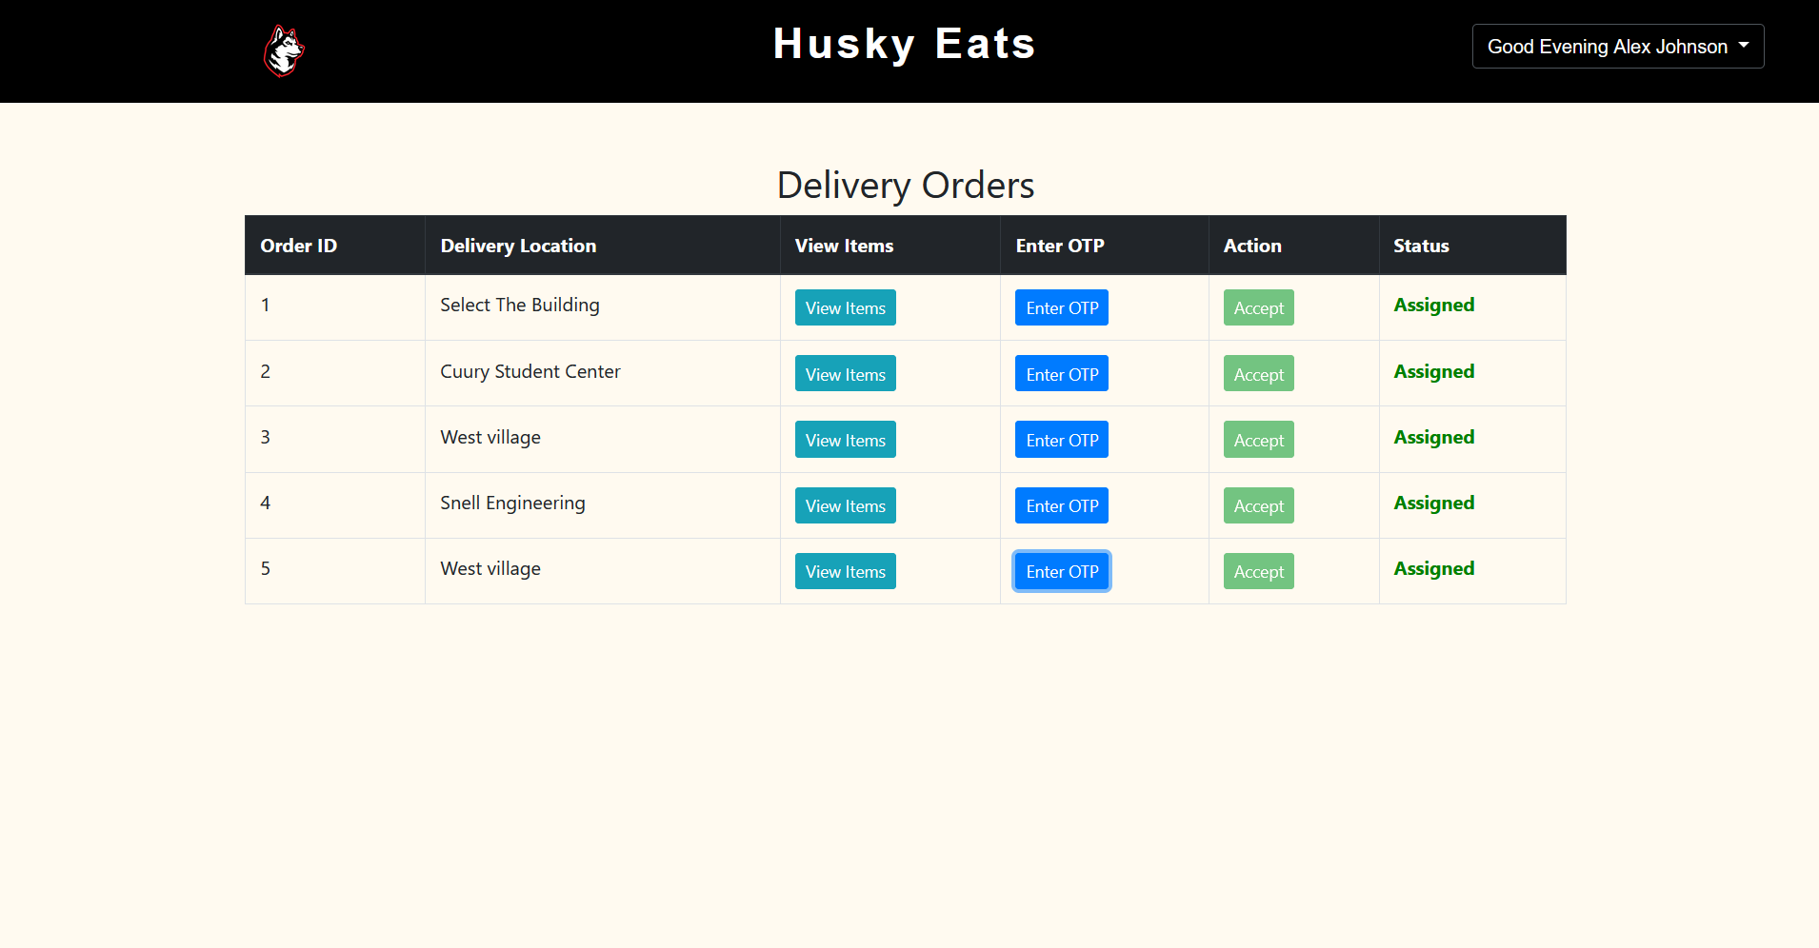
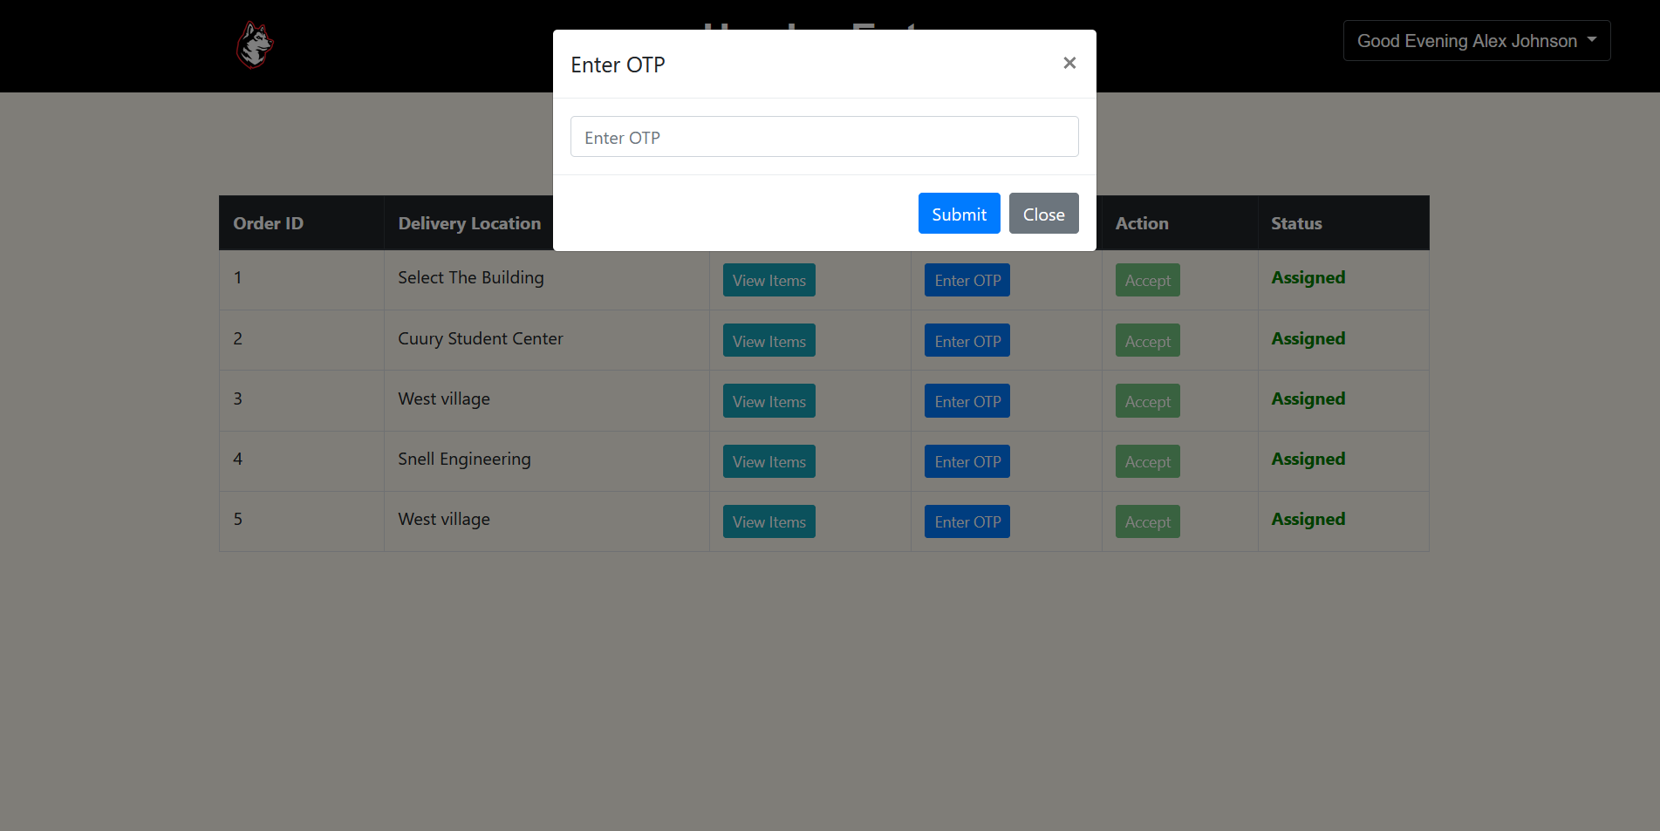
Delivery Agent Page
The Delivery Agent logs in with his/her respective credentials and can view all the orders.
The agent can view the items to be delivered before accepting the order but the agent has to accept the order to successfully deliver the order.
Once the agent accepts the order, the OTP button would be enabled and the agent has to enter the OTP given by the user .
When the agent accepts the order , the status changes to “Assigned”. When this is done the status changes to Order Delivered.

Slide 16
Rationale for choosing this Domain:
The university community's increasing demand for easy access to shopping and dining options is the reason behind the selection of this domain. Since faculties and students frequently have hectic schedules, a platform that combines groceries and meal services improves their overall experience. Furthermore, encouraging user connections through common dining experiences encourages local food culture and community involvement. In the end, Husky Eats promotes research and discovery of a variety of culinary products while attending to actual demands inside the university.

